Slide 1
Objects & Strings: Operators & Methods.
Week 5 | Lecture 1 (5.1)
While waiting, open the Jupyter Notebook for today’s lecture
Upcoming
NO lab due this Friday.
Lab 3 Released Thursday 6:00 pm.
Reflection 5 Released Friday 6:00 pm.
Tutorial (in-person AND online) running all week.
Practical sessions (in-person AND online) running ONLY Friday this week.

Slide 2
This Week’s Content
Lecture 5.1
Objects & Strings: Operators and Methods
Lecture 5.2
Strings: Conversions, Indexing, Slicing, and Immutability
Lecture 5.3
Introduction to Object-Oriented Programming and the File Object

Slide 3


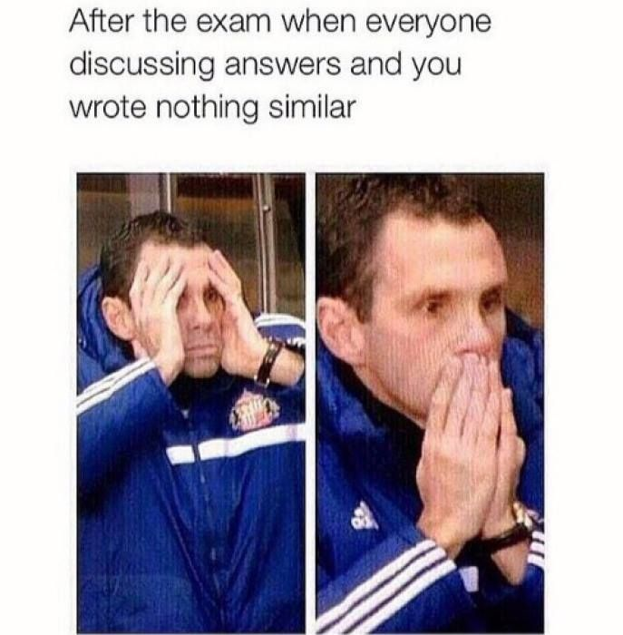



Slide 4
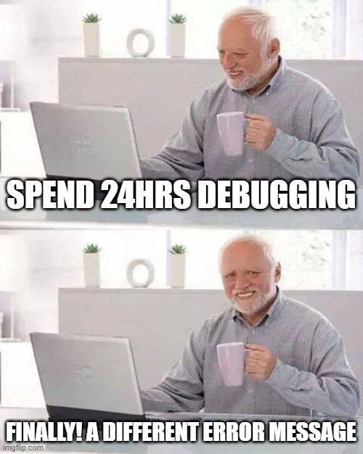
Error Reduction vs Debugging
It is pretty much impossible to write code without errors.
Error Reduction: techniques we can use to reduce the number and severity of errors.
Write Readable Code
Comment comment comment!
Test test test!
Debugging: techniques for identifying and correcting errors
How to use a debugger video coming in the How Does That Work? (HDTW) series on Quercus.
Do ‘software’/coding engineers need to worry about Designing for Safety?

Slide 5
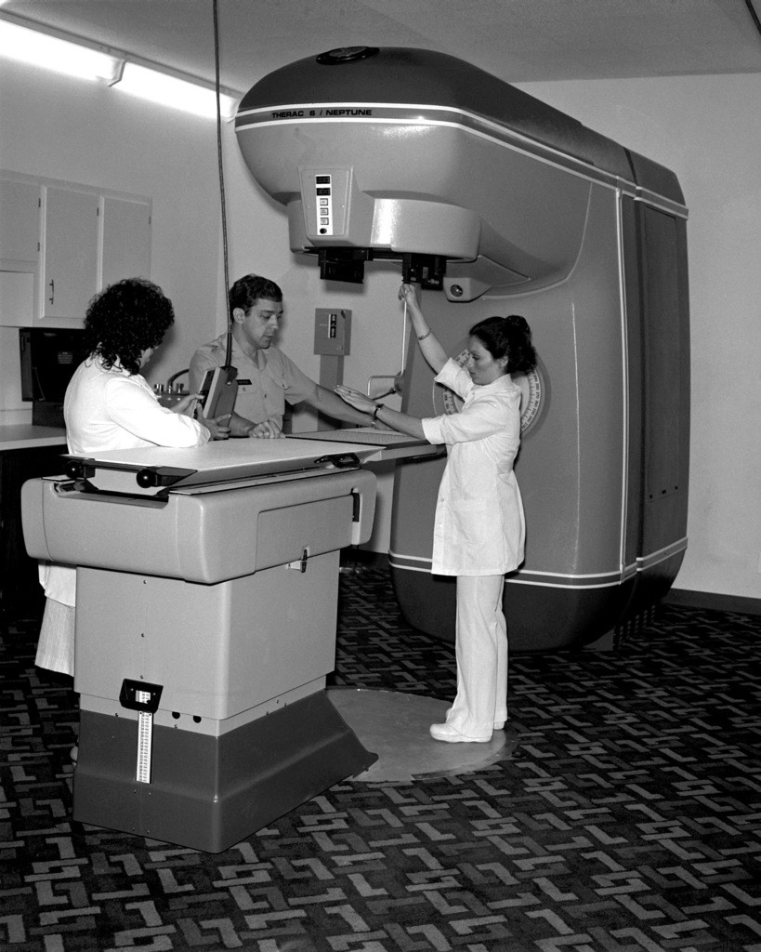
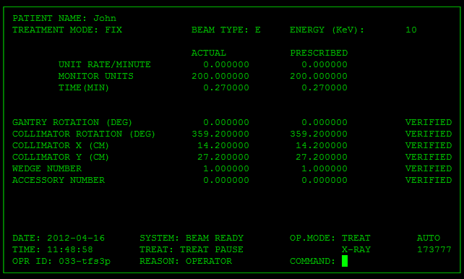
Therac-25: A Cancer Radiation Therapy Machine
”Improvement” on Therac-20
Previous versions used hardware guards
Therac-25 relied only on software
Meaningless error messages
Many misleading/incorrect errors
No clarification or mention of severity
MALFUNCTION 54
Nothing checked if the strength of radiation was appropriate
How might you fix this?
Notes:
In the 1980s, Therac was a popular computer-controlled radiation machine, used in cancer treatments. There were different generations, but when they released the Therac-25, they overlooked some critical bugs and safety features. The Therac-6 and Therac-20 had hardware safety guards, such as mechanical positioning guides to make sure the radiation is was positioned on the patient properly. The Therac-25 had no hardware guards, and relied solely on its software - unfortunately the software was not good enough. CLICK
One key issue that I’m sure a lot of you can relate to, is that the system was filled with so many bugs, incorrect warning messages, that it led experienced users and technicians to grow used to ignoring them and continuing treatment. The error messages were another problem, all of them labeled MALFUNCTION with a number from 1-64, with no mention of severity or further clarification. The biggest error in design is probably that, there was no final check in place that the strength and radiation mode was appropriate and target (area on the body) was aligned

Slide 6

Therac-25: An Engineering Disaster
Technicians began ignoring the misleading error messages
“the boy who cried wolf”
Machine delivered radiation hundreds of times greater than normal
4 patients died and others severely injured…
if radiation_level < max_safe_level:
give_radiation(radiation_level)
Notes:
- leading to 6 patients receiving radiation doses that were hundreds of times greater than normal, ultimately killing 4 of them. The way you design your software matters, and it’s important that you take just as much time considering safety as one would if they were designing a SpaceX rocket or a nuclear reactor.

Slide 7
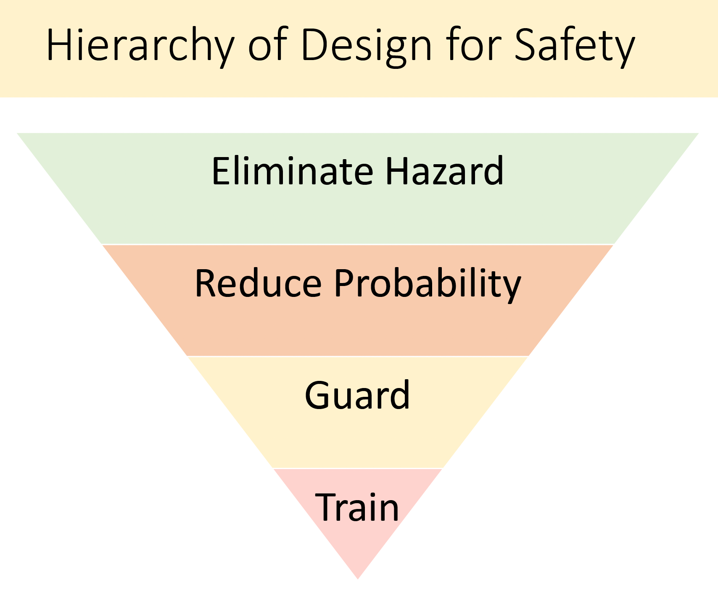
When Designing for Safety: Training/warnings/labels are the last resort!
Remember: No matter how bad today’s midterm went…
You are safe.
&
You didn’t harm anyone with incorrect code.

Slide 8


Let’s revisit our Turtle friend…
import turtle
LeBron = turtle.Turtle()
LeBron.right(90)
LeBron.forward(200)
LeBron.left(90)
LeBron.forward(100)
turtle.done()

Slide 9
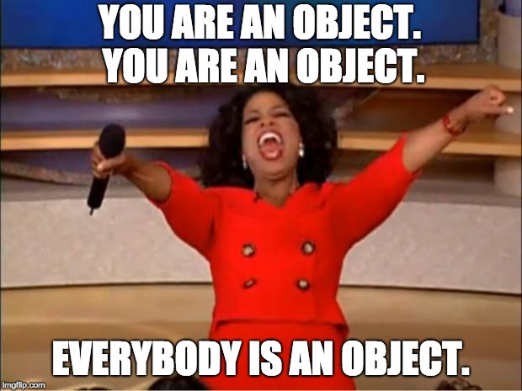
Everything is an Object!
Python keeps track of every value, variable, function, etc. as an object
There is a function that you can call to confirm:
>>> isinstance(4, int)
True
>>> isinstance(“Hello”, str)
True
>>> isinstance(4, object)
True
>>> isinstance(‘Hello”, object)
True

Slide 10
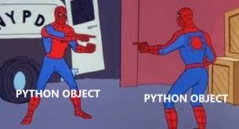
Everything is an Object!
Remember the id (or identity) function
It returns each object’s location in memory
>>> id(4)
4482837280
>>> id(int)
4482678880
>>> id(‘a’)
140432546199344
>>> id(str)
4482716800

Slide 11
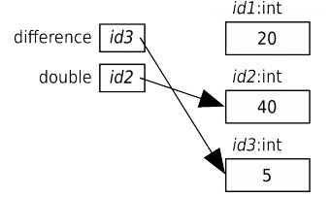
Memory Visualization Example
>>> difference = 20
>>> double = 2 * difference
>>> double
40
>>> difference = 5
>>> double
40
Notes:
Let’s go through an example of variable assignment and how this looks in memory. Understanding how memory works in your computer can help clear up how the computer thinks and how it’s interpreting what you’re saying.
So, looking at the first line, what is the variable? What is the expression?

Slide 12
Objects have Methods
Each Python object has certain functions that can only be applied to that object
These are called methods
The general form for calling a method is:
Since methods are applied to objects, we need to provide the object name with the “dot operator” (“.”) before the method name. Look familiar?
object_name.method_name(arguments)

Slide 13
Let’s revisit our friend LeBron…
import turtle
LeBron = turtle.Turtle()
LeBron.right(90)
LeBron.forward(200)
LeBron.left(90)
LeBron.forward(100)
turtle.done()

Slide 14
Let’s revisit our friend LeBron…
import turtle
LeBron = turtle.Turtle()
LeBron.begin_fill()
LeBron.color(‘red’)
LeBron.right(90)
LeBron.forward(200)
LeBron.left(90)
LeBron.forward(100)
LeBron.end_fill()
turtle.done()

Slide 15
Let’s Code!
Let’s take a look at how this works in Python!
id function to get object’s memory address
isinstance function to determine object type
Turtle LeBron drawing shapes!
Open your notebook
Click Link:
1. Objects & Methods

Slide 16
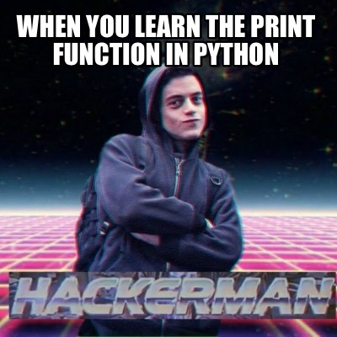
RECAP: Input and Output
Python has a built-in Input/Output functions:
print – for displaying text to the user
input – for reading text from the user
These functions require a good understanding of strings and string formatting

Slide 17
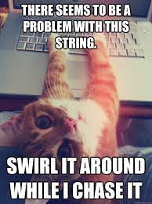
Working with Strings
The string (str) type was briefly introduced in previous weeks
Let’s take our string knowledge to the next level!
escape sequences
str operations
type conversion
str indexing and slicing
str methods

Slide 18
Escape Sequences
Special character called an escape character: \ (backslash)
When used in a string, the character following the escape character is treated differently from normal.
Escape sequence | Name | Example | Output
\n | newline (ASCII - line feed) | “How\nare\nyou?” | How are you?
\t | tab (ASCII - horizontal tab) | ‘3\t4\t5’ | 3 4 5
\\ | backslash (\) | ‘\\’ | \
\’ | single quote (‘) | ‘don\’t’ | don’t
\” | double quote (”) | “He says, \”Hi\”.” | He says, “hi”.

Slide 19
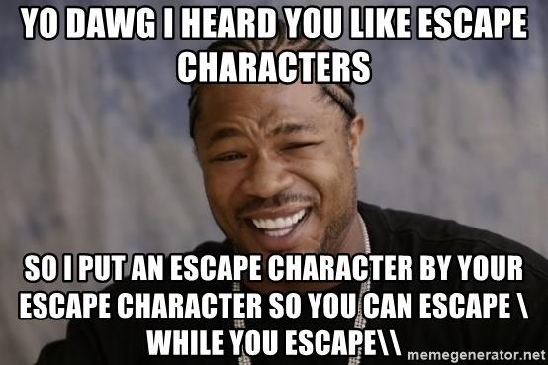
Let’s Code!
Let’s take a look at how this works in Python!
Working with the print function
Escape sequences!
New lines
Tabs
Quotes
Open your notebook
Click Link:
2. Escape Sequences

Slide 20
String Operators
There are certain mathematical operators that can be applied on strings
The * and + obey standard precedence rules (i.e. * before +)
All other mathematical operators and operands result in a TypeError
Expression | Name | Example | Output
str1 + str2 | concatenate str1 and str1 | print('ab' + 'c') | abc
str1 * int1 | concatenate int1 copies of str1 | print('a' * 5) | aaaaa
int1 * str1 | concatenate int1 copies of str1 | print(4 * 'bc') | bcbcbcbc

Slide 21
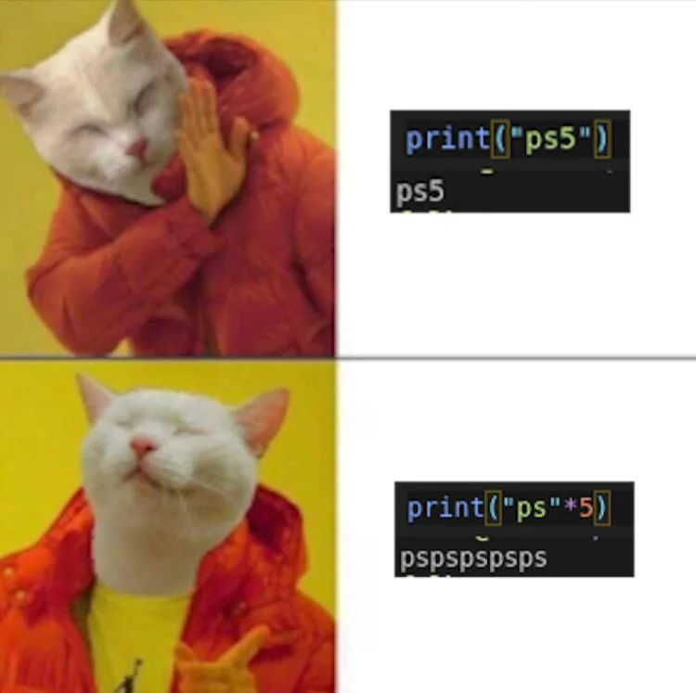
Let’s Code!
Let’s take a look at how this works in Python!
Concatenation
+ operator
* operator
Open your notebook
Click Link:
3. String Operators

Slide 22

Working with Strings
The string (str) type was briefly introduced in previous weeks
Let’s take our string knowledge to the next level!
escape sequences
str operations
type conversion
str indexing and slicing
str methods

Slide 23
Type Conversion
The built-in function str takes any value and returns a string representation of that value
Like our built-in functions int and float that can take a string and attempt to return a number representation of the string
>>> str(4) ‘4’
>>> str(4482678880) ‘4482678880’
>>> int('12345')
12345
>>> int(-99.9) -99
>>> float(‘-43.2’) -43.2
>>> float(’432’) 432.0

Slide 24
Let’s Code!
Let’s take a look at how this works in Python!
Type conversion
int/float to string
string to int/float
Open your notebook
Click Link:
4. Type Conversions

Slide 25
Breakout Coding Session!
Ask the user how many times they would like to see the string ”knock knock knock… Penny” repeated. Then, print it!
Can you customize the name?
Open Python (PyCharm or Jupyter)
Work with your table to solve this problem!

Slide 26
Consider this…
Ask the user how many times they would like to see the string ”knock knock knock… Penny” repeated, and print it!
Can you customize the name?
Hints for getting started:
Ask the user for a number of times (think: input function)
Remember input function returns a string…
Repeated string (think: concatenation, * operator might be useful)
Make the output readable (think: escape characters)

Slide 27
Objects & Strings: Operators & Methods.
Week 5 | Lecture 1 (5.1)

